Slide 1
GFS and NFS
Yubin Xia

Slide 2
Intro to GFS

Slide 3
Background
In 2003
50+ GFS clusters
Each with thousands of storage nodes
Managing petabytes of data
GFS is under lots of applications and other systems in Google, such as bigtable, etc.
Built on top of commodity machine and disks
Tailored for Google workloads

Slide 4
Introduction to GFS
Shares the same goals as previous distributed file systems
Performance, Scalability, Reliability, Availability
But with some differences:
Component failures are considered the norm rather than the exception
Files are huge by traditional standards.
Most files are mutated by appending new data rather than overwriting existing data
Co-designing the file system and applications increases flexibility in development

Slide 5
Design Assumptions
System is built from commodity hardware which fails as the norm
The system must be able to detect and recover from such occurrences
The system must be optimized to deal with large files (multi-GB)
Two types of reading
Large streaming reads
Small random reads

Slide 6
Design Assumptions
Large sequential writes
Appending data to files which are seldom altered again.
Atomicity in concurrent writes from multiple clients
High sustained bandwidth is more valuable than low latency

Slide 7
Typical workloads on GFS
Two kinds of reads: large streaming reads & small random reads
Large streaming reads usually read 1MB or more
Oftentimes, applications read through contiguous regions in the file
Small random reads are usually only a few KBs at some arbitrary offset
Also many large, sequential writes that append data to files
Similar operation sizes to reads
Once written, files are seldom modified again
Small writes at arbitrary offsets do not have to be efficient
Multiple clients (e.g. ~100) concurrently appending to a single file
e.g. producer-consumer queues, many-way merging

Slide 8
GFS Interface
Not POSIX-compliant, but supports typical file system operations: create, delete, open, close, read, and write
snapshot: creates a copy of a file or a directory tree at low cost
record append: allow multiple clients to append data to the same file concurrently
At least the very first append is guaranteed to be atomic

Slide 9
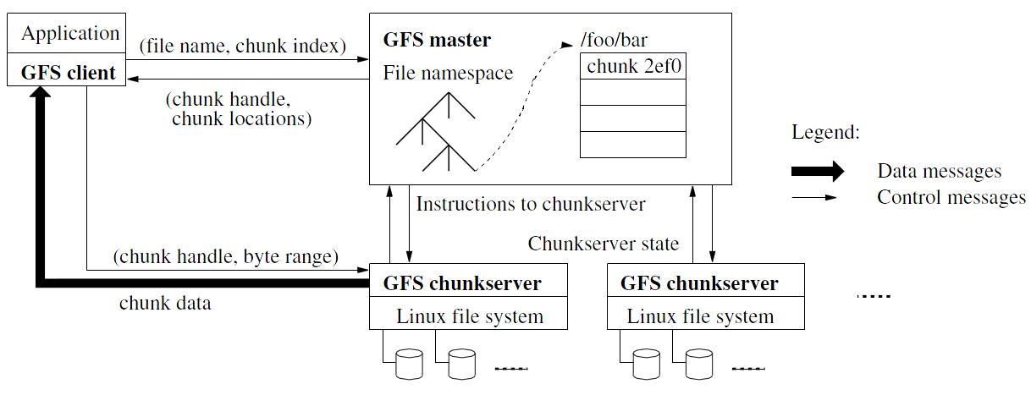
Architecture

Slide 10
Design Architecture
GFS Cluster (accessed by clients)
Single Master + Multiple Chunkservers
Chunkserver
Files of fixed sized chunks
Each chunk has a globally unique 64-bit chunk handle.
Master
Maintains file system metadata
Namespace
Access Control Information
Mapping from files to chunks
Current locations of chunks

Slide 11
Design Architecture
Principle: data flow is decoupled from control flow
Clients interact with the master for metadata operations
Clients interact directly with chunkservers for all files operations
This means performance can be improved by scheduling expensive data flow based on the network topology
Neither the clients nor the chunkservers cache file data
Working sets are usually too large to be cached, chunkservers can use Linux’s buffer cache

Slide 12
Single Master Node
Clients do not read or write through the master
The master relays relevant chunkserver location information to the client
The client temporarily caches the chunkserver data and directly accesses the chunkserver
Shadow Masters (fault tolerance)

Slide 13
Metadata on Master
Three major types:
Chunk namespaces
Mapping from files to chunks
Location of chunk replicas
Chunk location is not stored persistently and is instead read on each startup
Metadata is stored in memory
Namespaces and file-to-chunk mappings are also stored persistently in operation log
Master monitors chunk location through heartbeat messages with each chunk.

Slide 14
Metadata on Master
For the namespace metadata
Master does not use any per-directory data structures
No inodes! No symlinks or hard links, either
Every file and directory is represented as a node in a lookup table, mapping pathnames to metadata
Stored efficiently using prefix compression
< 64 bytes per namespace entry
Each node in the namespace tree has a corresponding read-write lock to manage concurrency
Because all metadata are stored in memory, the master can efficiently scan the entire state of the system periodically in the background
Master’s memory capacity does not limit the size of the system

Slide 15
The Operation Log
Only persistent record of metadata
Also serves as a logical timeline that defines the serialized order of concurrent operations
Master recovers its state by replaying the operation log
To minimize startup time, the master checkpoints the log periodically
The checkpoint is represented in a B-tree like form, can be directly mapped into memory, but stored on dis
Checkpoints are created without delaying incoming requests to master, can be created in ~1 minute for a cluster with a few million files

Slide 16
Chunkserver
Contains chunks (blocks) of a fixed size
64 MB
Fewer chunk location, fewer metadata
Chunks are replicated regularly
Default: 3-way mirror (across machines and racks)
Talks with master through heartbeat messages
This let’s master determines chunk locations and assesses state of the overall system
The chunkserver has the final word over what chunks it does or does not have on its own disks – not the master

Slide 17
Chunk Size
64 MB, a key design parameter (Much larger than most file systems)
Disadvantages:
Wasted space due to internal fragmentation
Small files consist of a few chunks, which then get lots of traffic from concurrent clients
This can be mitigated by increasing the replication factor
Advantages:
Reduces clients’ need to interact with master (reads/writes on the same chunk only require one request)
Since client is likely to perform many operations on a given chunk, keeping a persistent TCP connection to the chunkserver reduces network overhead
Reduces the size of the metadata stored in master → metadata can be entirely kept in memory

Slide 18
Why a Single Master?
The master now has global knowledge of the whole system, which drastically simplifies the design
But the master is (hopefully) never the bottleneck
Clients never read and write file data through the master; client only requests from master which chunkservers to talk to
Master can also provide additional information about subsequent chunks to further reduce latency
Further reads of the same chunk don’t involve the master, either

Slide 19
Why a Single Master?
Master state is also replicated for reliability on multiple machines, using the operation log and checkpoints
If master fails, GFS can start a new master process at any of these replicas and modify DNS alias accordingly
“Shadow” masters also provide read-only access to the file system, even when primary master is down
They read a replica of the operation log and apply the same sequence of changes
Not mirrors of master: they lag primary master by fractions of a second
This means we can still read up-to-date file contents while master is in recovery!

Slide 20
System Interactions
Mutation
Write
Append
Acts on all of the chunk’s replicas
Lease
Initial timeout of 60 seconds, which can be renewed or revoked.
Data Flow
Decoupled control flow from data flow
Data pushed linearly to avoid bottlenecks and high latency links

Slide 21
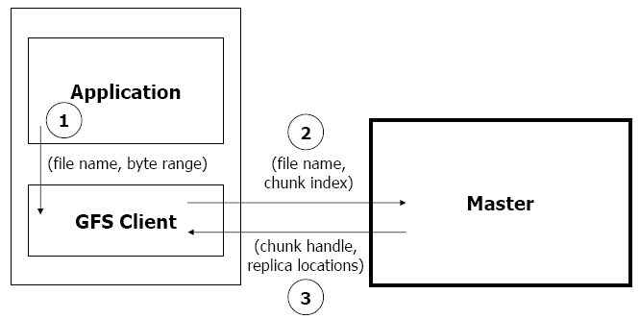
Read Algorithm

Slide 22
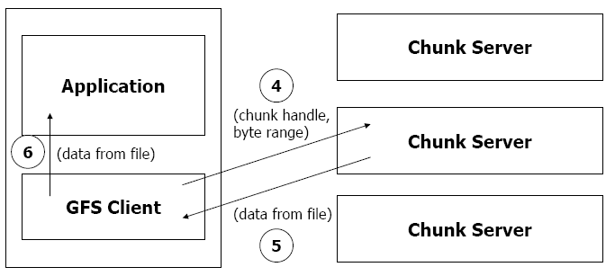
Read Algorithm

Slide 23
Read Algorithm
1. Application originates the read request.
2. GFS client translates the request from (filename, byte range) -> (filename, chunk index), and sends it to master.
3. Master responds with chunk handle and replica locations (i.e. chunk servers where the replicas are stored).
4. Client picks a location and sends the (chunk handle, byte range) request to that location.
5. Chunk server sends requested data to the client.
6. Client forwards the data to the application.

Slide 24
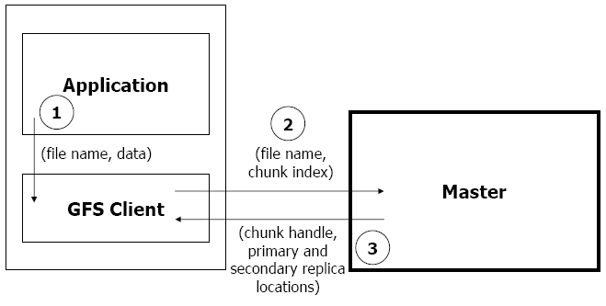
Write Algorithm

Slide 25
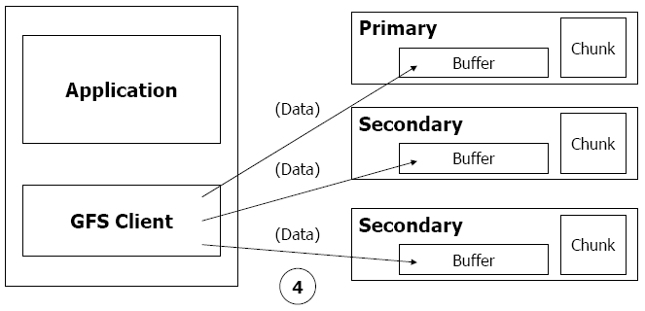
Write Algorithm

Slide 26
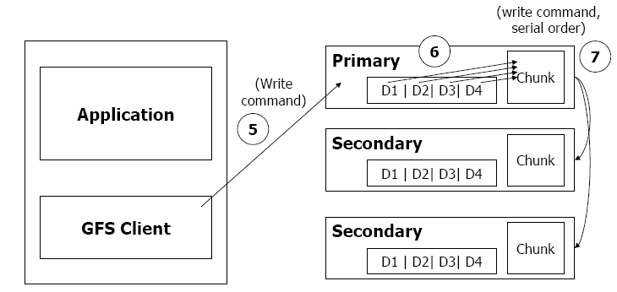
Write Algorithm

Slide 27
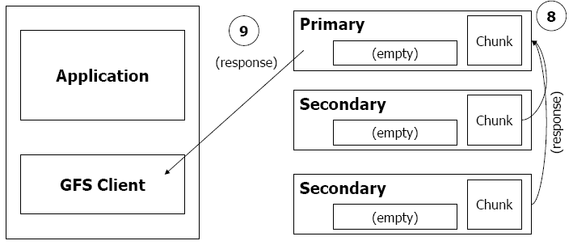
Write Algorithm

Slide 28
Write Algorithm
1. Application originates write request.
2. GFS client translates request from (filename, data) -> (filename, chunk index), and sends it to master.
3. Master responds with chunk handle and (primary + secondary) replica locations.
4. Client pushes write data to all locations. Data is stored in chunkservers’ internal buffers.
5. Client sends write command to primary.

Slide 29
Write Algorithm
6. Primary determines serial order for data instances stored in its buffer and writes the instances in that order to the chunk.
7. Primary sends serial order to the secondaries and tells them to perform the write.
8. Secondaries respond to the primary.
9. Primary responds back to client.
Note: If write fails at one of chunk servers, client is informed and retries the write.

Slide 30
Master Operation
Replica Placement
Creation, Re-replication, Rebalancing
Garbage Collection
Stale Replica Detection

Slide 31
Fault Tolerance and Diagnosis
Fast recovery
Master and chunkserver are designed to restore their states and start in seconds
Chunk replication : 3-way mirrors
Across multiple machines, across multiple racks

Slide 32
Fault Tolerance and Diagnosis
Master Mechanisms:
Log of all changes made to metadata
Periodic checkpoints of the log
Log and checkpoints replicated on multiple machines
Master state is replicated on multiple machines
“Shadow” masters for reading data if “real” master is down

Slide 33
Fault Tolerance and Diagnosis
Data integrity
A chunk is divided into 64-KB blocks
Each with its 32-bit checksum
Verified at read and write times
Also scans for rarely used data in background

Slide 34
Summary of GFS
Runs on commodity hardware and is scalable
Performs well for the specified tasks and assumptions previously mentioned
Innovation
File system API tailored to stylized workload
Single-master design to simplify coordination
Metadata fit in memory

Slide 35
Summary of GFS
Flat namespace
Dedicated Care for Component Failure
hard disk failure, data corruption, network disconnection, etc.
High-throughput
Minimized the master involvement
Chunk servers themselves send and receive the client data
The master leases authority to mutate chunks

Slide 36
Intro to NFS

Slide 37
Accessing Remote Files
FTP, telnet, …
Explicit access
User-directed connection to access remote resource
We want more transparency
Allow user to access remote resource just as local ones
NAS: Network Attached Storage

Slide 38
File Service Types
Upload/Download model
Read file: copy file from server to client
Write file: copy file from client to server
Advantage
Simple
Problem
Wasteful “what if client needs small piece?”
Problematic “what if client doesn’t have enough space?”
Consistency “what if others modify the same file?”

Slide 39
File Service Types
Remote access model
File service provides functional interface (create, delete, read, write, etc …)
Advantage
Client gets only what’s needed
Server can manage coherent view of file system
Problem
Possible server and network congestion
Servers are accessed for duration of file access
Same data may be requested repeatedly

Slide 40
Remote File Service
File Service
Provides file access interface to clients
Directory Service
Maps textual names for file to internal locations that can be used by file service
Client module (driver)
Client side interface for file & directory service
If done right, helps provide access transparency
e.g. implement the FS under the VFS layer

Slide 41
Semantics of File Sharing
Sequential semantics
Read returns result of last write
Easily achieved if
Only one server
Clients do not cache data
BUT
Performance problem if no cache
We can write-through
Must notify clients holding copies
Requires extra state, generates extra traffic

Slide 42
Semantics of File Sharing
Session semantics
Relax the rules
Changes to an open file are initially visible only to the process that modified it
Last process to modify the file wins

Slide 43
Accessing Remote Files
Implement the client module as an FS under VFS
System Call Interface
VFS
Sockets
ext4
procfs
RemoteFS
Network Protocols
Network
NIC
Kernel-level sockets interface

Slide 44
Server: Stateful or Stateless
Stateful →
Shorter requests
Better performance in processing requests
Cache coherence is possible
Server can know who’s accessing what
File locking is possible
Server maintains client-specific state
Notes:
State: e.g., offset, ..

Slide 45
Server: Stateful or Stateless
Stateless →
Each request must identify file and offsets
Server/Client can crash and recovery
No state to lose
No open/close needed
No server space used for state (scalable)
Problems if file is deleted on server
File locking not possible
Server maintains no info for client

Slide 46
Caching
Hide latency to improve performance for repeated accesses by bringing the data closer to where it’s needed
Three places to replicate data
Server’s buffer cache
Client’s buffer cache
Client’s disk
WARNING:
Potential cache consistency problem

Slide 47
Approaches to Caching
Write-through
Keep data cached at the client but send modifications to the server
What if another client reads its own (out-of-data) cache copy?
All accesses will require checking with server
Or … server maintains state of clients and sends invalidations

Slide 48
Approaches to Caching
Delayed writes (write-behind)
Data is cached locally (watch out for consistency – others won’t see updates)
Remote files updated (immediately) periodically
One bulk write is more efficient than lots of little writes
Problem: semantics become ambiguous

Slide 49
Approaches to Caching
Read-ahead (prefetch)
Request chunks of data before it is needed
Minimize wait when it actually is needed
Write on close
Admit that we have session semantics
Centralized control
Keep track of who has what open and cached on each node
Stateful file system with signaling traffic

Slide 50
NFS: Network File System
Design Goals
Any machine can be a client or server
Must support diskless workstations
Heterogeneous system must be supported
Different HW, OS, underlying file system
Access transparency
Recovery from failure
Stateless, UDP, client retries
High performance
Use caching and read-ahead

Slide 51
NFS Protocols: Mount
Mounting Protocol: Request access to exported directory tree
Client sends pathname to server
Requests permission to access contents
Server returns file handle
Client: parses pathname
contacts server for file handle
Client: create in-memory VFS inode at mount point
internally points to rnode for remote files (client keeps state, not the server)

Slide 52
NFS Protocols: Mount
Static mounting
mount request contacts server
Server:
add list of shared directories to /etc/exports
Client:
mount r900:/users/paul /home/paul

Slide 53
NFS Protocols: Access
Directory and File Access Protocol: Access files and directories (read, mkdir, …)
First, perform a lookup RPC
Returns file handle and attributes
“lookup” is not like “open”
Establish state on the client only (no information on server)
Call the NFS lookup function
The handle passed as a parameter for other file access function
e.g., read(handle, offset, count)

Slide 54
NFS Performance
Usually slower than local
Improve by caching at client
Goal: reduce number of remote ops
Caching: read, readlink, getattr, lookup, readdir
Cache file data at client (buffer cache)
Cache file attribute information at client
Cache pathname bindings for faster lookup
Server side
Caching is “automatic” via buffer cache
All NFS writes are write-through to disk
Notes:
buffer cache has no relation with file states (e.g., open/close): they are at different layers.

Slide 55
Validation
Inconsistencies may arise in NFS
Try to resolve inconsistency by validation
Save timestamp of file
When file opened or server contacted for new
Compare last modification time
If remote is more recent, invalidate cached data
Always invalidate data after some time
open files (3 sec), directories (30 sec)
If data block is modified, it is:
Marked dirty, then flushed on file close

Slide 56
Improving Read Performance
Transfer data in large chunks
8KB default
Read-ahead
Optimize for sequential file access
Send requests to read disk blocks before they are requested by the applications

Slide 57
Problem with NFS
File consistency
Assumes clocks are synchronized
Open with append can’t be guaranteed to work
Locking cannot work
Separate lock manager added (stateful)
No reference counting of open files
You can delete a file opened by yourself/others
Global UID space assumed
…

